Slide 1
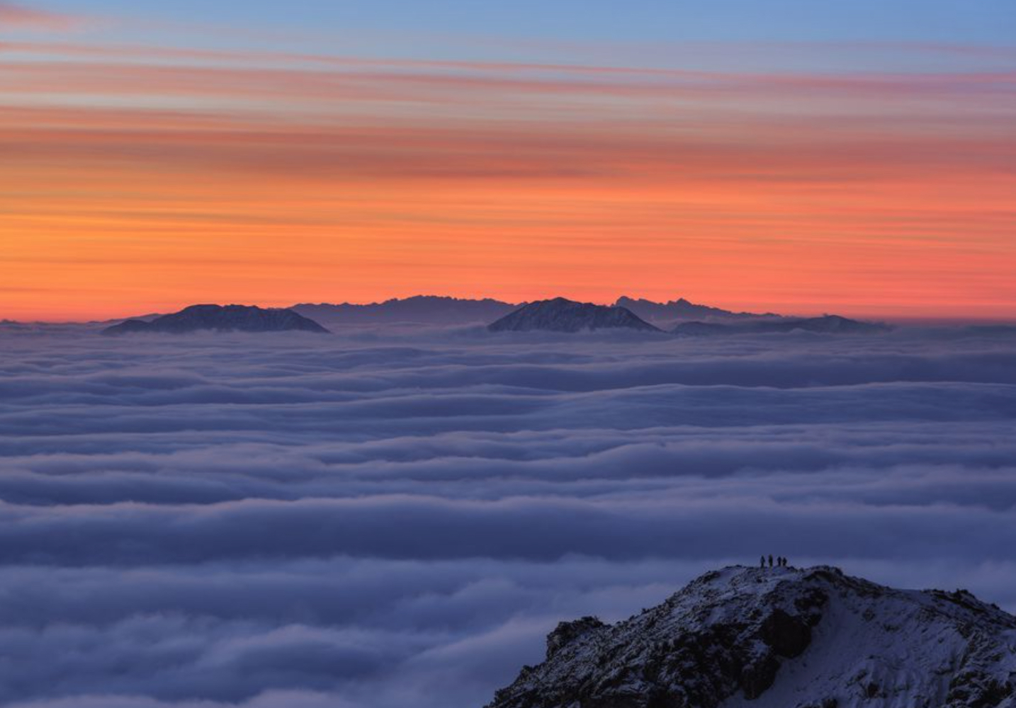
Finding Naturally Appealing Palettes
https://github.com/cxc13513/color-match Catherine Chen

Slide 2
Process Overview
Scrape photos from National Geographic & Extract main color palette from photos using DBSCAN
find complementary color palettes by calculating silhouette score
Build web app to visualize color options
Validation & Next Steps

Slide 3
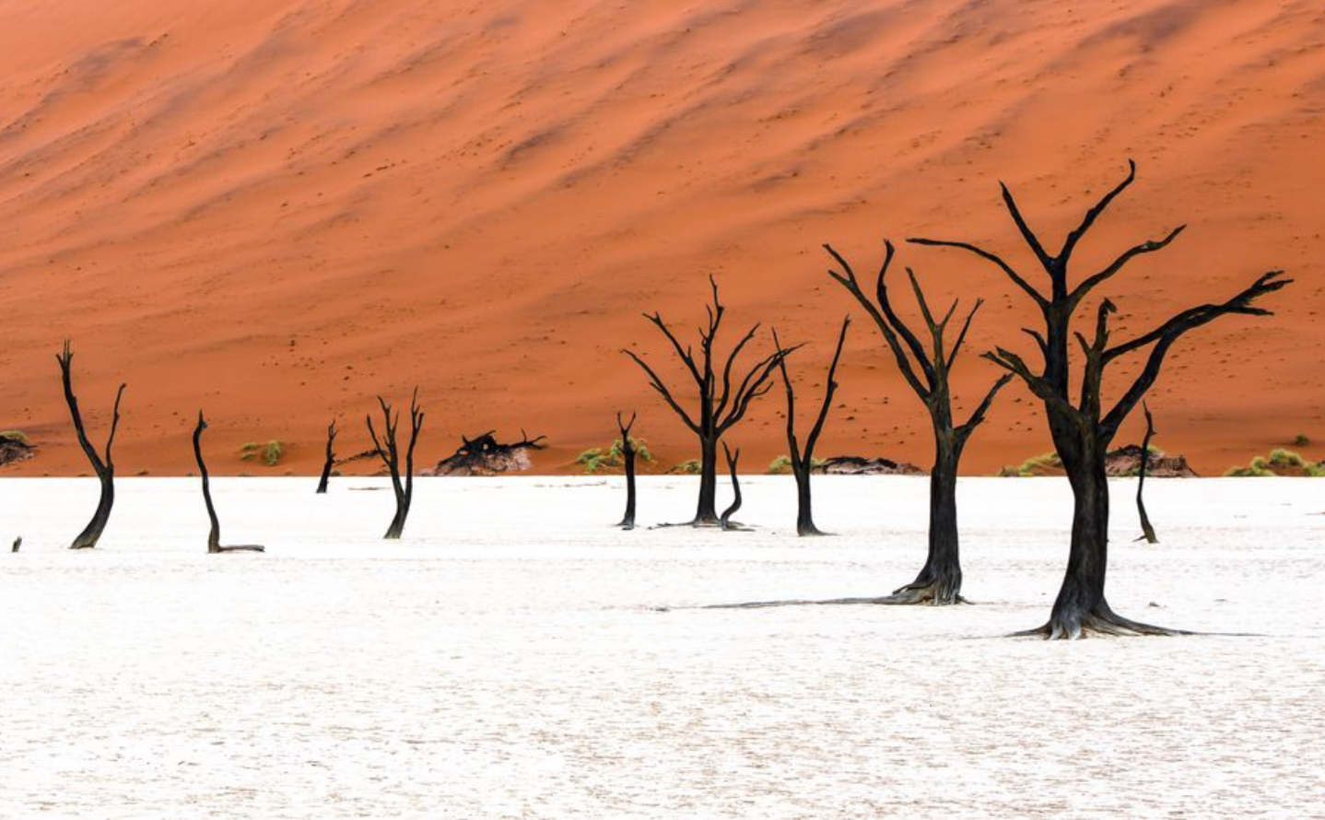
Scrape top nature photos from Nat Geo
& extract main color palettes using DBSCAN to cluster in RGB color space

Slide 5
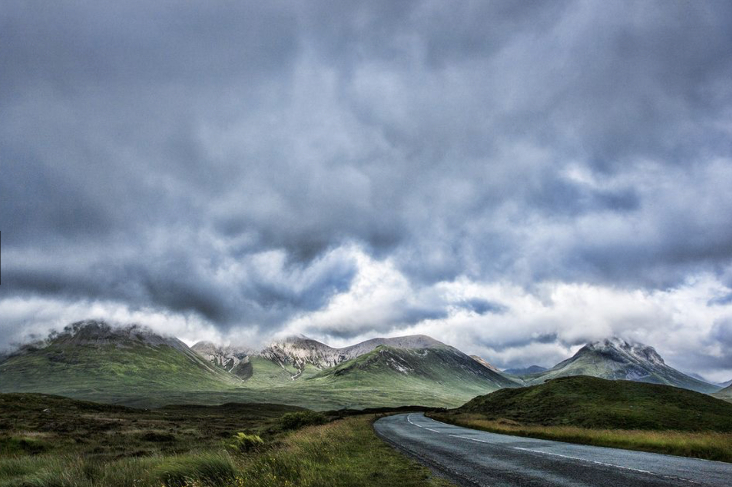
Find complementary color palettes by calculating silhouette score? Filler? Throw out?

Slide 6
Upload a photo
See suggestions
See base palette

Slide 7
Validation
Baseline:
No clustering, take 15 most frequent RGB values from each picture.
Not quite nuanced enough for extracting main color palette.

Slide 8
Extracted Colors
Extracted Colors
Suggested Colors
Suggested Colors

Slide 9
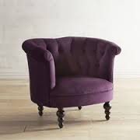
Extracted Colors
Extracted Colors
Suggested Colors
Suggested Colors

Slide 10
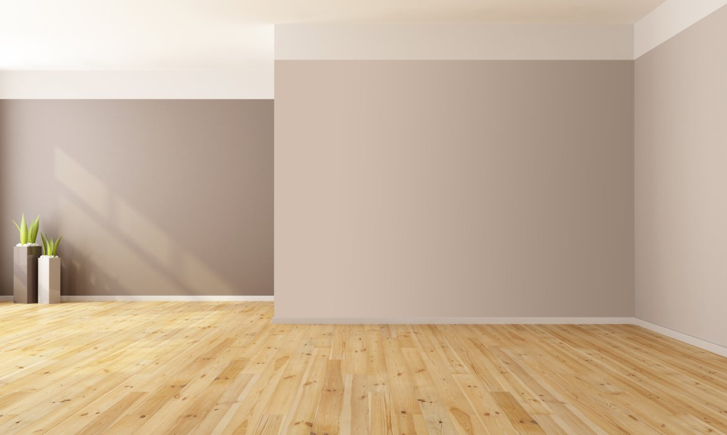
Extracted Colors
Extracted Colors
Suggested Colors
Suggested Colors

Slide 11
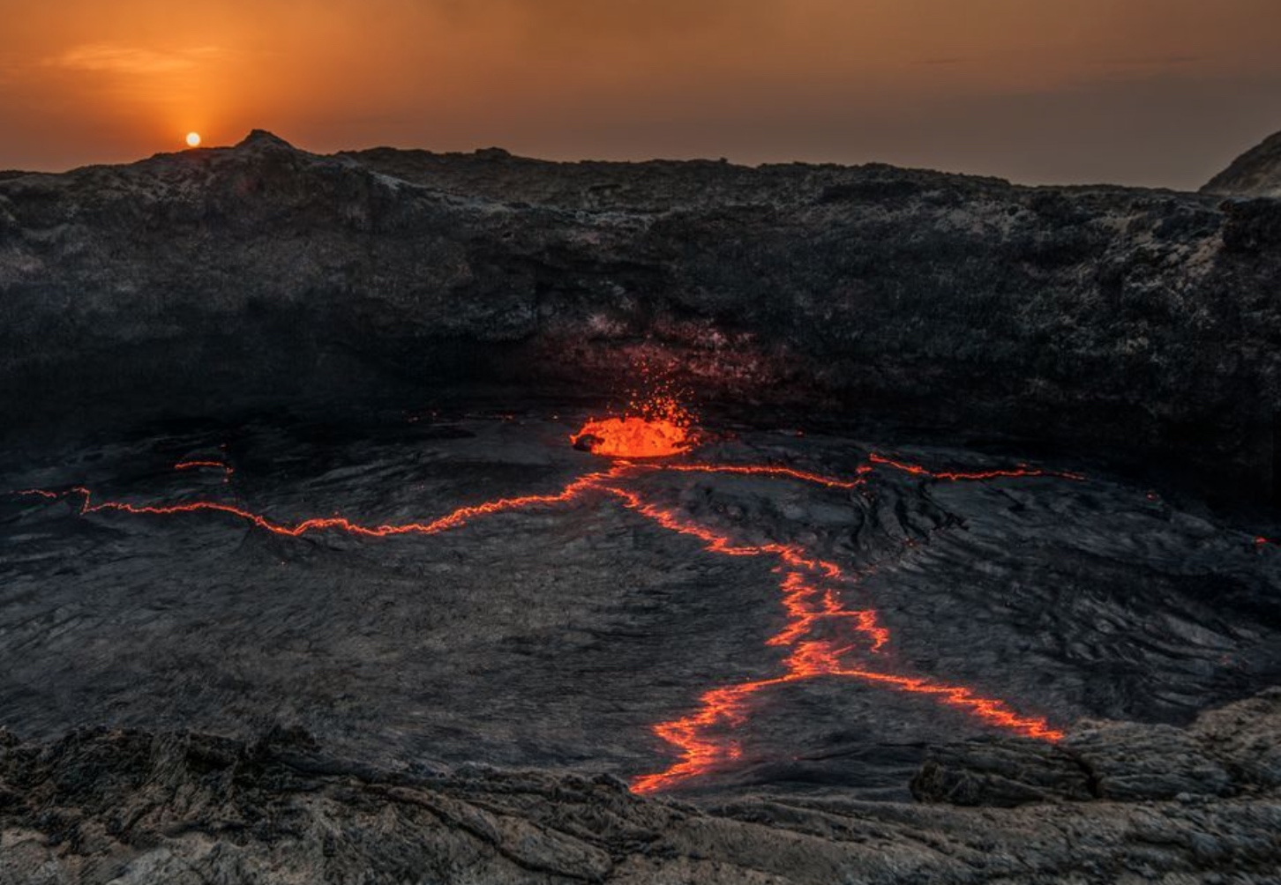
Next Steps
More robust validation method
DBSCAN very sensitive to params (epsilon & min_sample) – find a way to adjust params for each picture I extracted information from
Instead of using RGB values, use alternative color metrics that are more in-line with human perception of color. E.g., HSV
Make results page more user friendly → maybe include links to some products with those colors?

Slide 12
Find complementary palettes
silhouette score: measures similarity of two sets of points in RGB color space
No overlapping colors: score ~ 1
Some overlapping colors: score ~ 0
One set entirely overlapped: score ~ -1
Notes:
Calculating the silhouette score allowed me to measure how similar two color palettes are to each other.
Usually the silhouette score ranges between 1 and -1. I rebased it to range between 2 and 0 for my purposes.
Score of 2: no overlap, distinct sets
Score of 1: some overlap, distinct sets
Score of 0: one set is entirely subsumed within another

